Slide 1
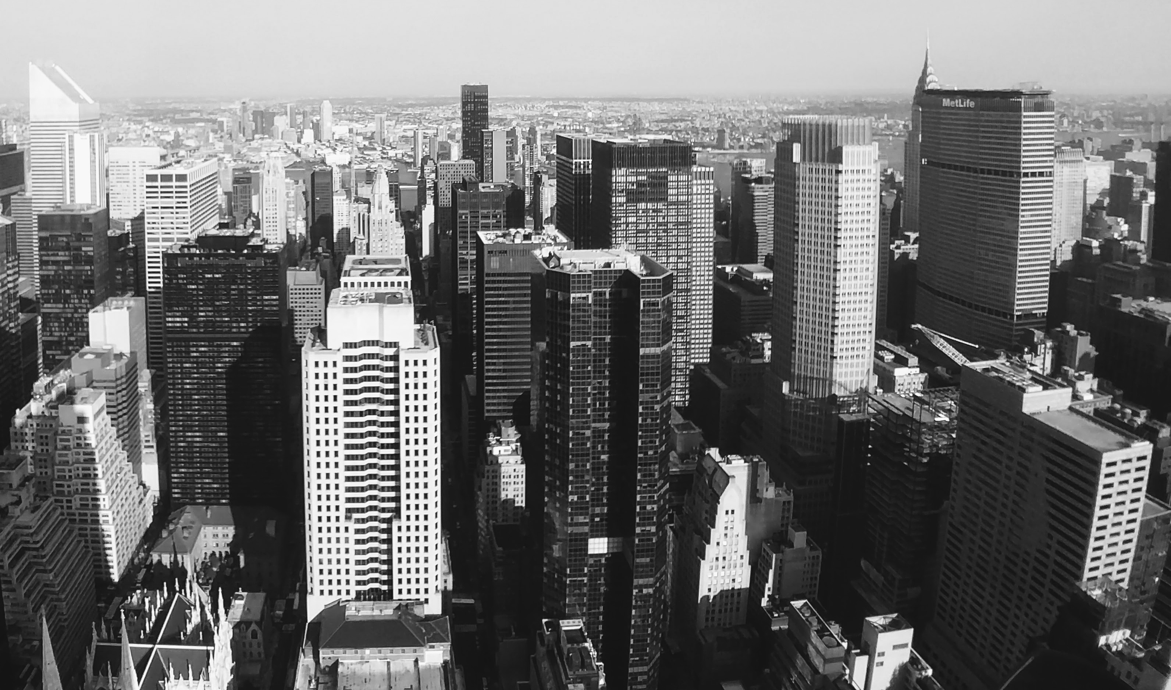
FREDERICTON TRAFFIC ACCIDENTS

Slide 2
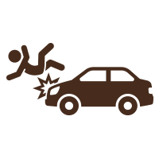

DATASETS
I
TRAFFIC ACCIDENTS
Accident GPS coordinates
Streets
Types of Accidents
No. of injured/killed
SIGNALS
GPS Co-ordinates
No. of Signals
Streets

Slide 3

Present population
vs
No. of injured in last 10 years
58220
Present Population of Fredericton.
4%
9900 Accidents
2260 are injured in the year 2007 - 2017

Slide 4

Accident prone streets
TRAFFIC ACCIDENTS
DATA
INSIGHTS
Types of Accidents
Probable Reasons of Accidents

Slide 5
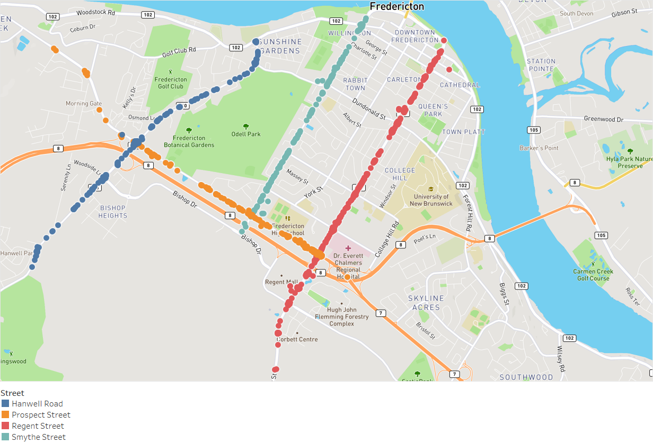
ACCIDENT PRONE STREETS
50%
6.99%
10.80%
Canada
SYMTHE STREET
PROSPECT STREET
6.44%
21.54%
HANWELL STREET
50%
REGENT STREET

Slide 6
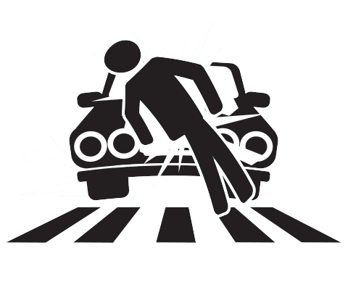
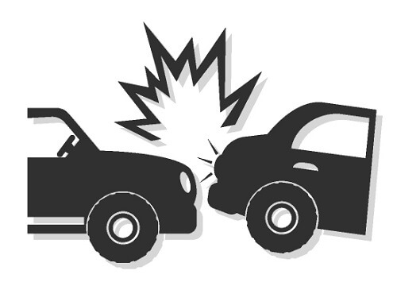
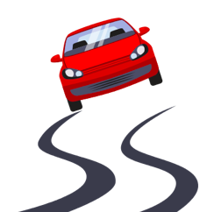
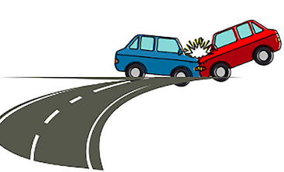
TYPES OF ACCIDENTS
16 Types of Accidents are occurring in Fredericton.
We have considered these top 4 type of Accidents as it constitutes 60% of total accidents.
9.9%
PEDESTRIAN
REAR END COLLISIONS
27.63%
VEHICLE LOST CONTROL
10.39%
TURNING
15.79%

Slide 7




DISTRACTED DRIVING
HOARDING
PETS IN VECHILE
DROWSY
MOBILE USAGE

Slide 8
TRAFFIC ACCIDENTS AND TRAFFIC SIGNALS
DATA
INSIGHTS
DOES NUMBER OF SIGNALS AFFECT ACCIDENTS ?

Slide 9
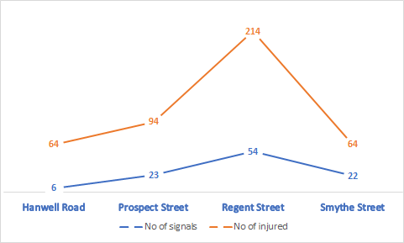
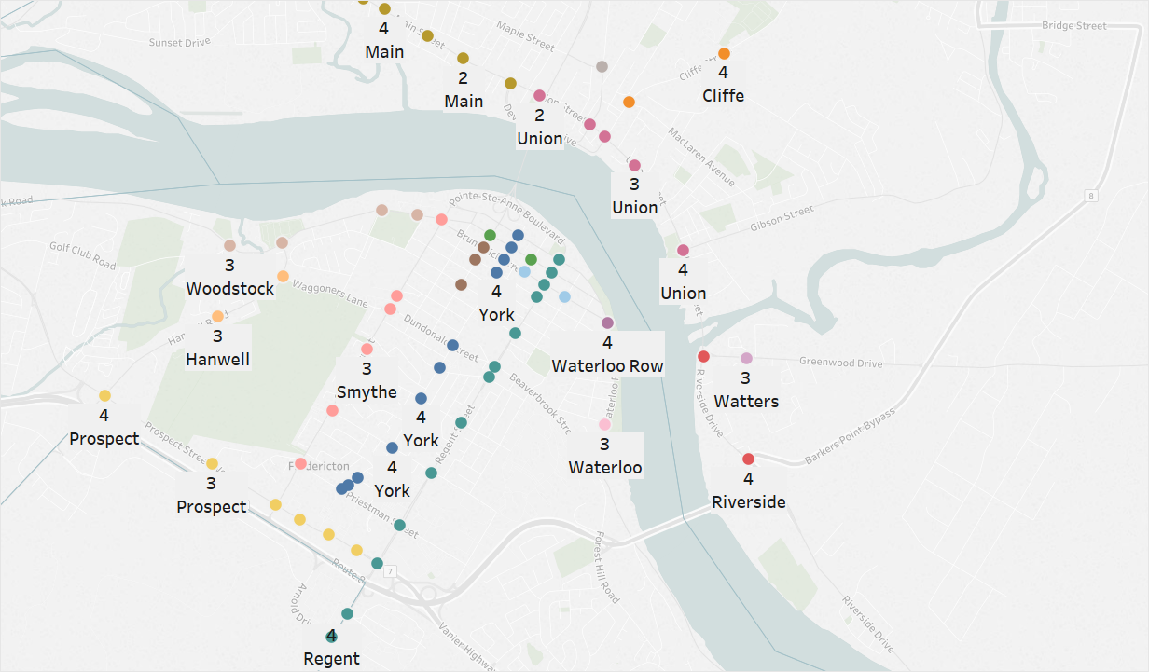

CORRELATING ACCIDENTS WITH CROSSINGS
Number of Accidents $∝$ Number of Crossings.
8

Slide 10
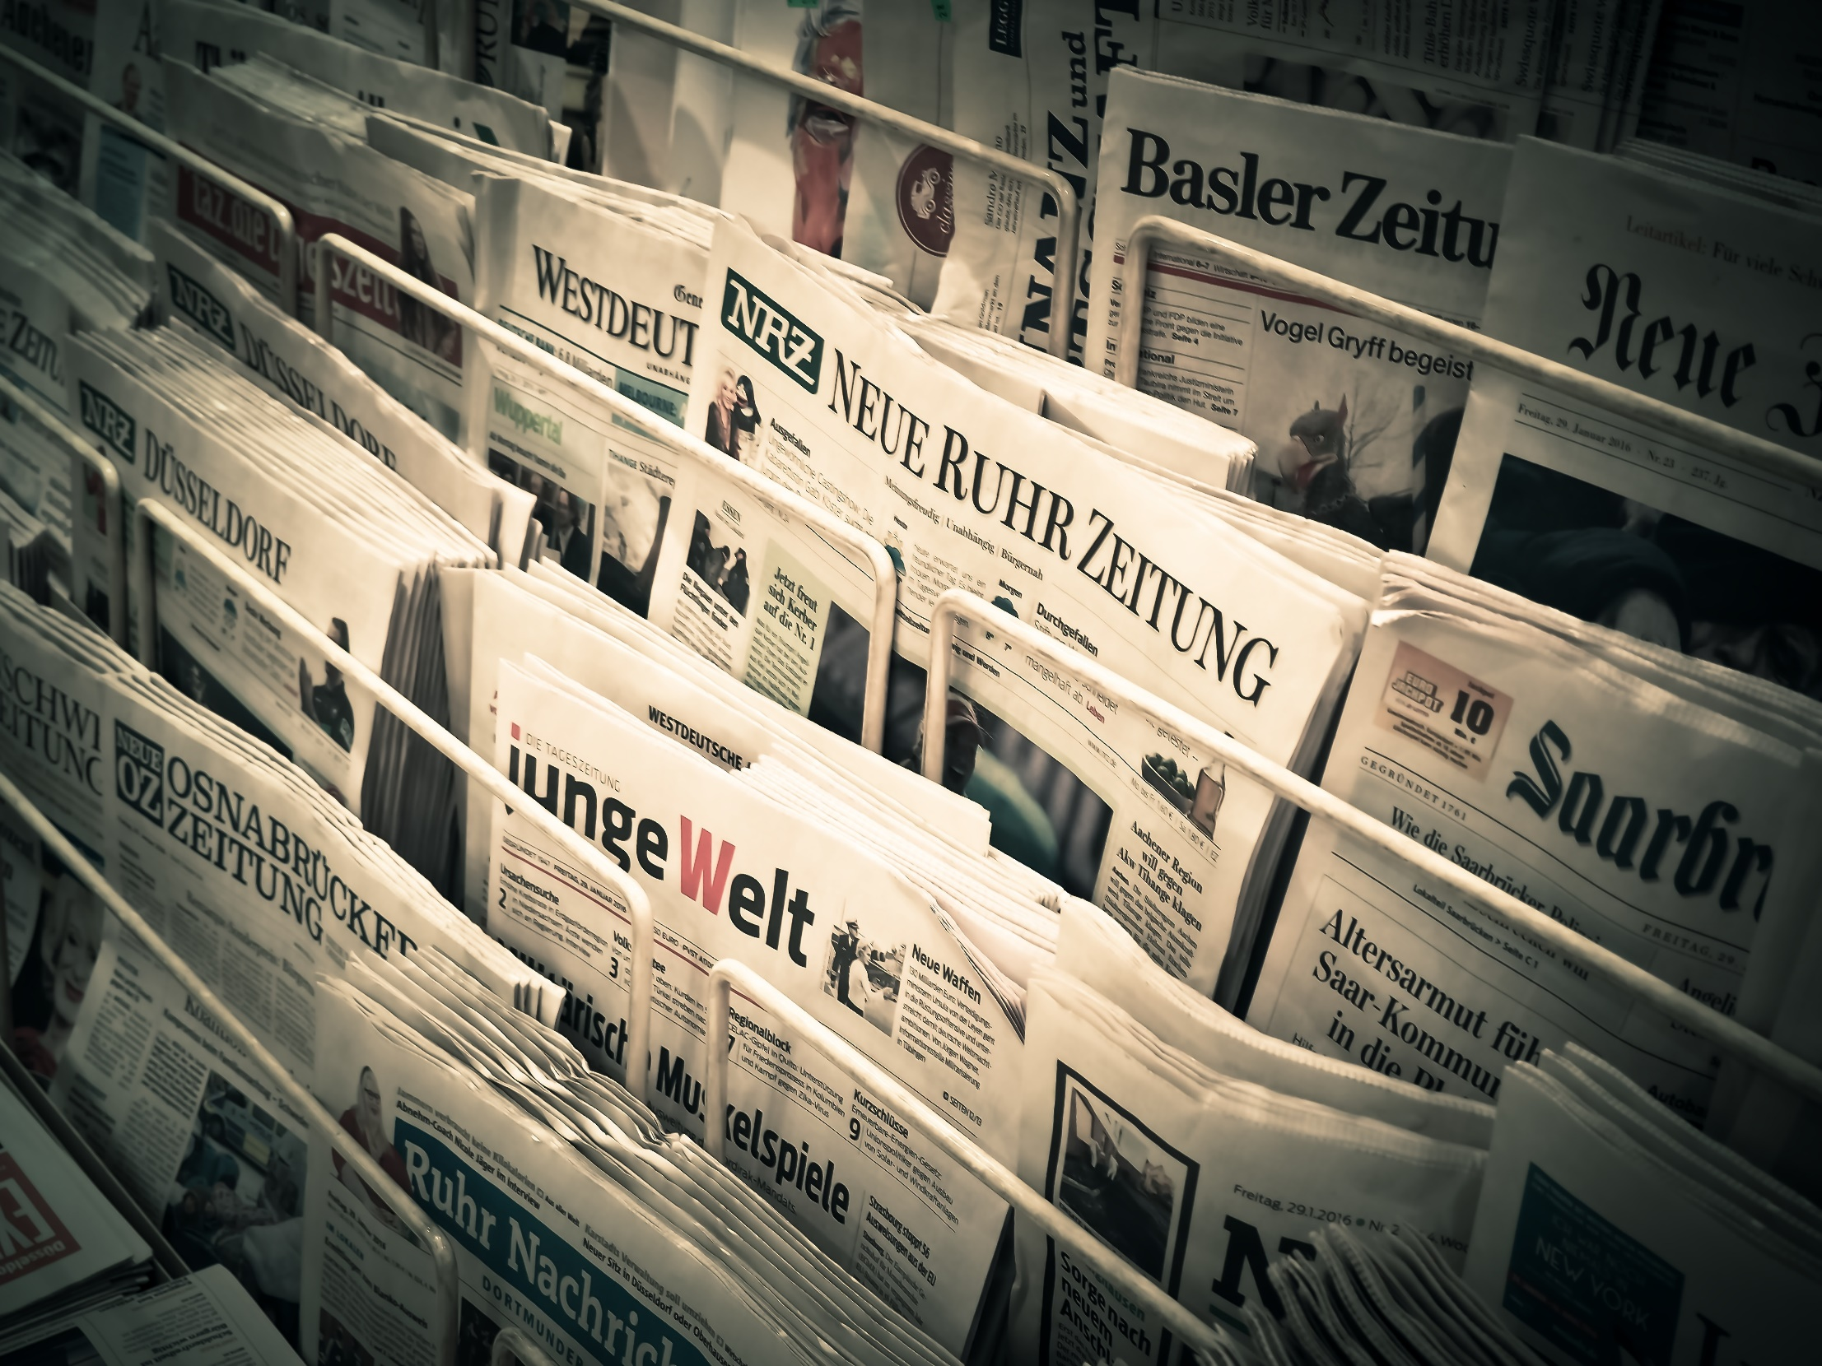



1
2
3
4
RECOMMENDATIONS

Slide 11

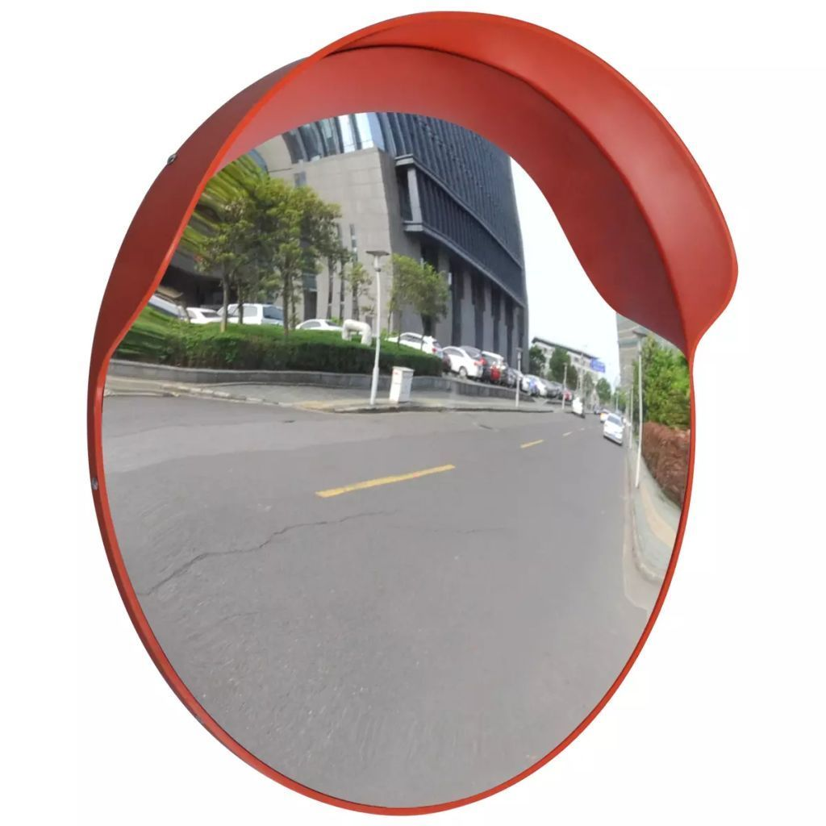
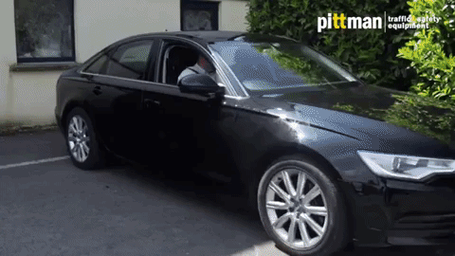
#1 RECOMMENDATON – CONVEX MIRRORS
Install convex mirrors at blind curves.
It helps in diminution of/ It will lead to decline in turning accidents.

Slide 12
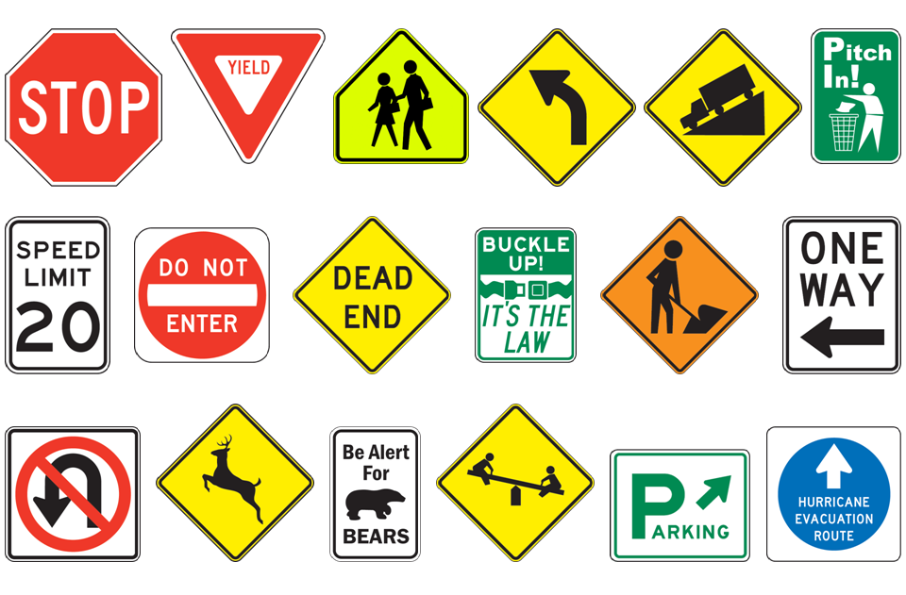
#2 RECOMMENDATON – SIGN BOARDS

Slide 13
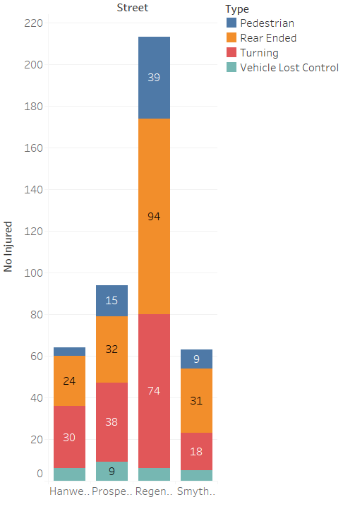
INSIGHTS ON REGENT STREET
In Regent street the top 5 accidents are:
Rear Ended
Turning
Pedestrian
Vehicle Lost Control
Failing to stop(red light)
To avoid the above accidents we can install sign boards customized for each street.

Slide 14
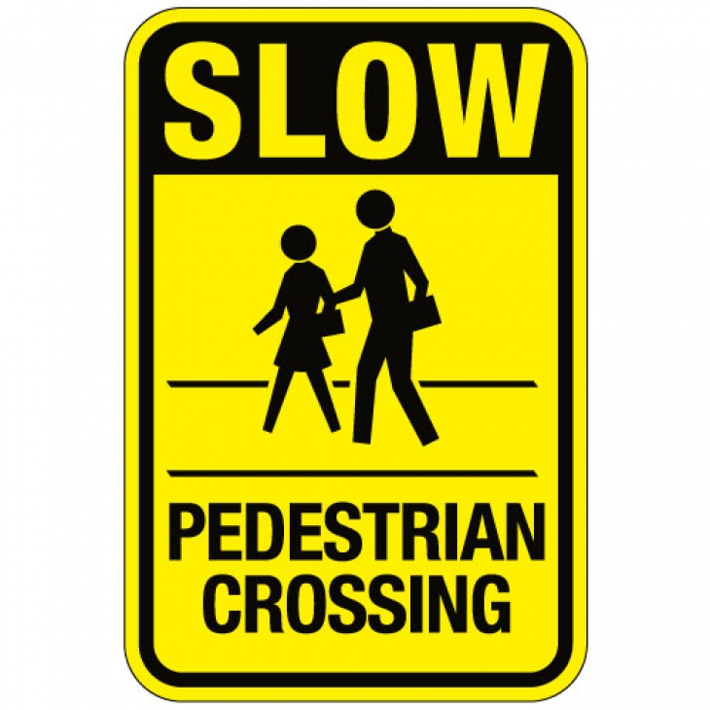
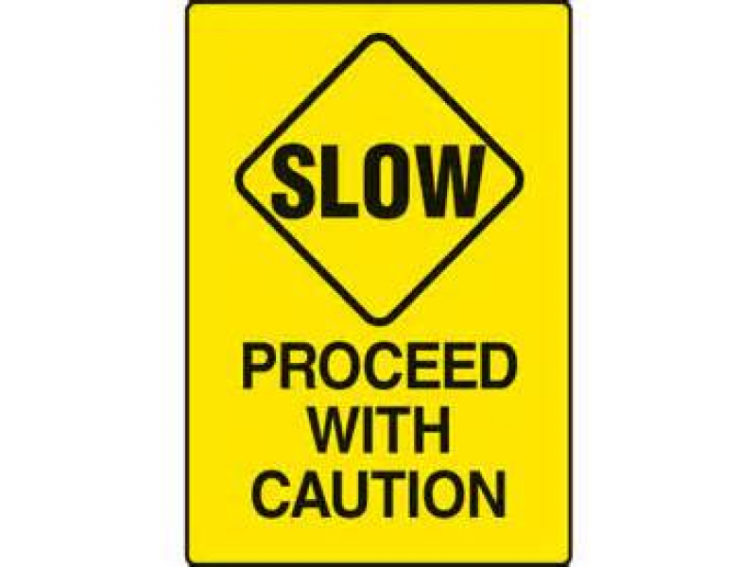
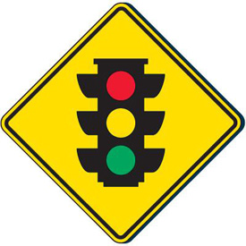


Slide 15
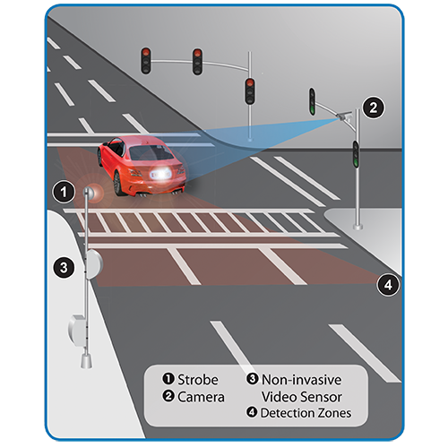
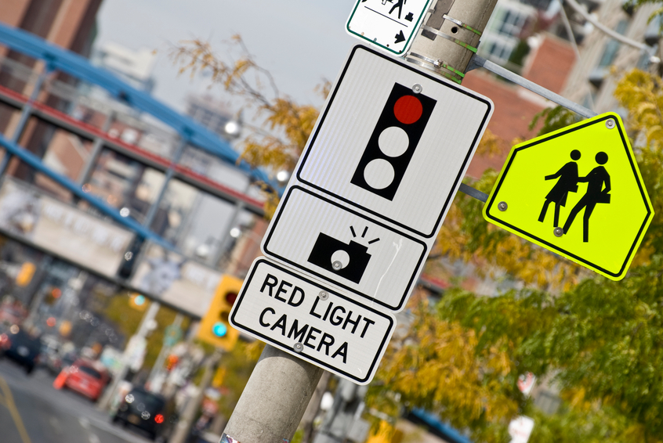
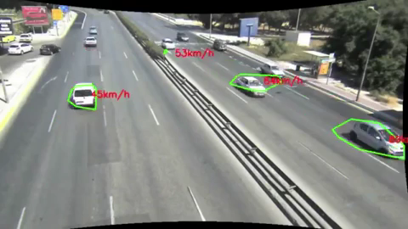
Traffic cameras to prevent Accidents
#1 RECOMMENDATON – CONVEX MIRRORS
#3 RECOMMENDATON – TRAFFIC CAMERAS
Speed Cameras
If the speed of the vehicle exceeds the legal limit, or a vehicle runs a red light, a digital record of license plate taken of the offending vehicle.
Red Light Cameras
During the red phase, the camera catches motorists who run the red light.
During the green phase, the camera catches motorists who exceed the speed limit.
The objective is to make people stick to the rules of the traffic, no speed no ticket.

Slide 16
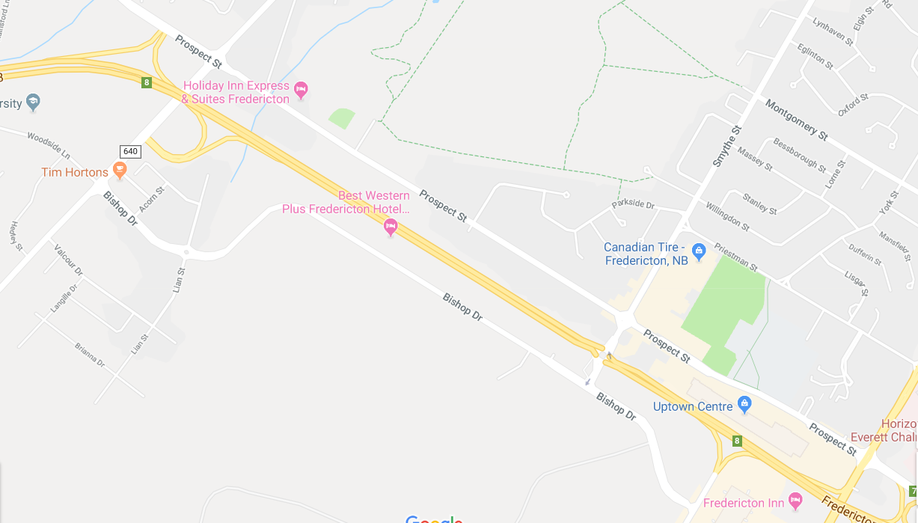



#1 RECOMMENDATON – CONVEX MIRRORS
#4 RECOMMENDATON – VOICE ASSITANT USING GPS
Warning! Construction ahead, drive carefully!

Slide 17
POPULAR RESEARCH REPORT ON RECOMMENDATIONS
Installing traffic cameras, saves 60% of society costs, which includes costs of personal injuries, property damage, and to health systems
Year
Values
$ 1,672,054
2018
- 3.567%
2019
+ 1.007%
2020
+ 2.012%
Market Value
2021
+ 4,031%

Slide 18
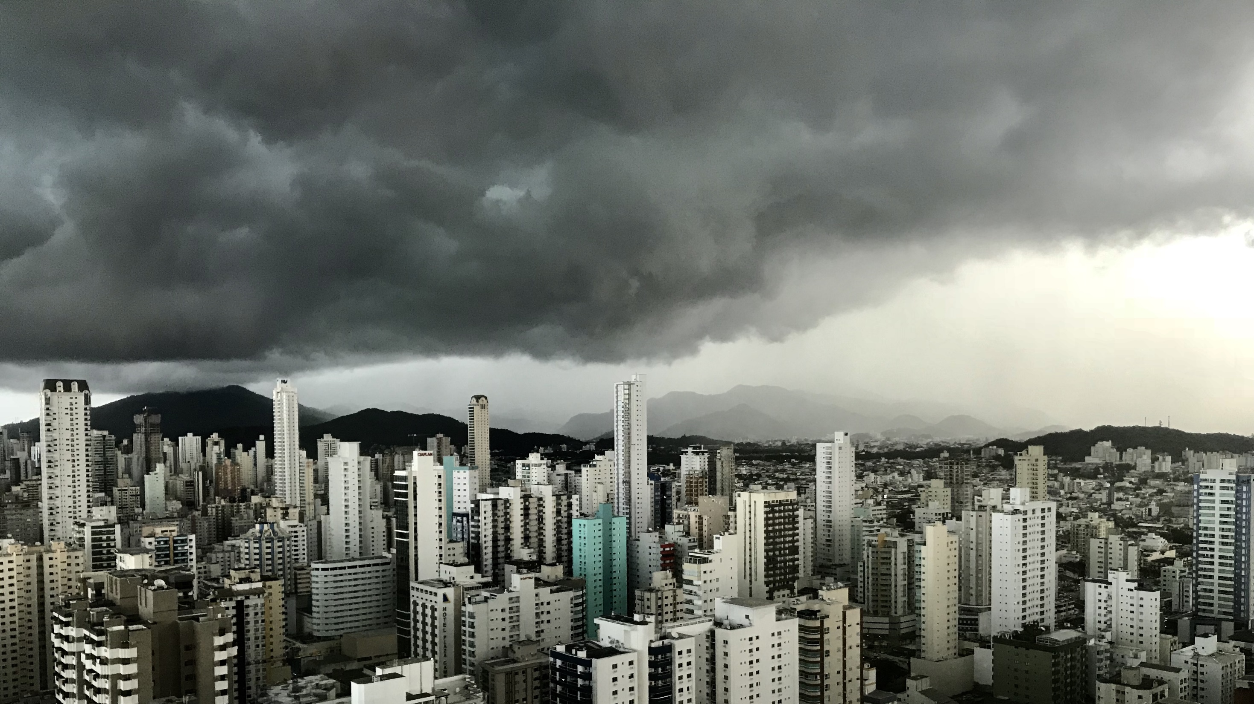
THANK YOU

